Slide 1
Twitter Airline Sentiment Analysis - Executive Summary

Slide 2
Twitter Dataset
This Dataset is from Kaggle
It is based on Tweets made in 2015 about 6 different airline:
American Airline
Delta Airline
United Airline
US Airways
Virgin America
There are three business questions for this project
What are the main reasons for the negative tweets? Which airline has the worst rating for each negative reason?
What is the overall positive, negative and neutral sentiment per airline? What are the top three negative reasons why for each airline?
What were top ten most common words used in the tweets and did they indicate anything about the airline?

Slide 3
Analysis Review
Variables I kept:
Airline: Name of the Airline
Airline_sentiment: Whether the Airline Sentiment is Positive, Negative or Neutral
Airline_sentiment_confidence: How confident the sentiment analysis is that the airline sentiment is correct
Negativereason: Negative reason why the tweet was posted (Ie Late Flight)
Negativereason_confidence: How confident the sentiment analysis is that the negative reason is correct
Retweet_count: Number of times the Tweet was retweeted
Text: The actual Tweet text
Variables I Removed:
Tweet_id: The Twitter user’s ID
Airline_sentiment_gold: No Data Provided
Negativereason_gold: No Data Provided
Tweet_coord: Coordinates from where the Tweet was sent
User_timezone: Timezone from where the Tweet was sent
Tweet_location: The location from where the Tweet was sent
Name: Name of Twitter User
Tweet_created: Date and time for when each Tweet was
posted

Slide 4
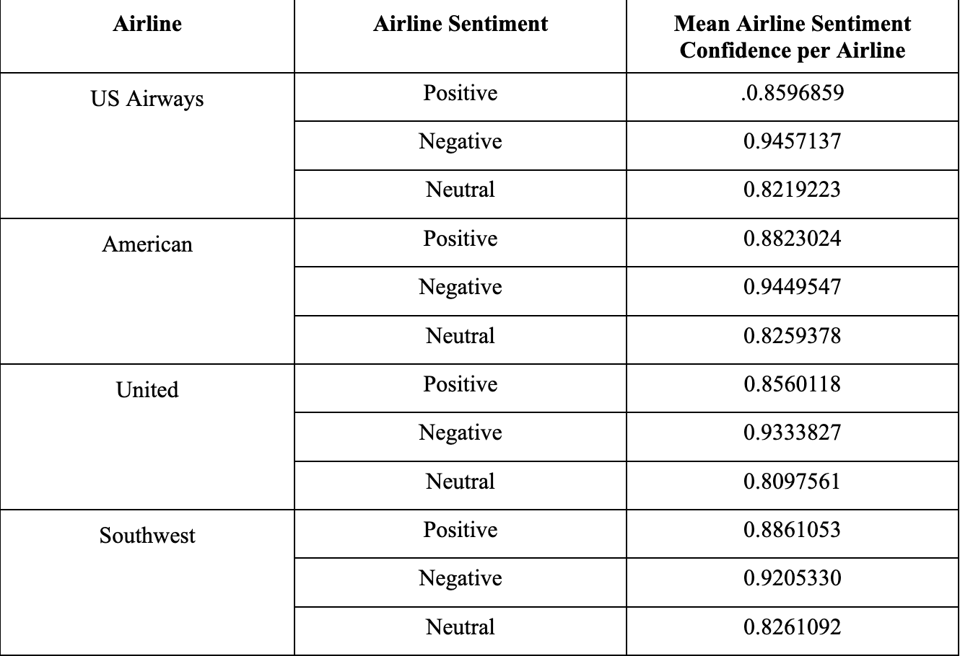
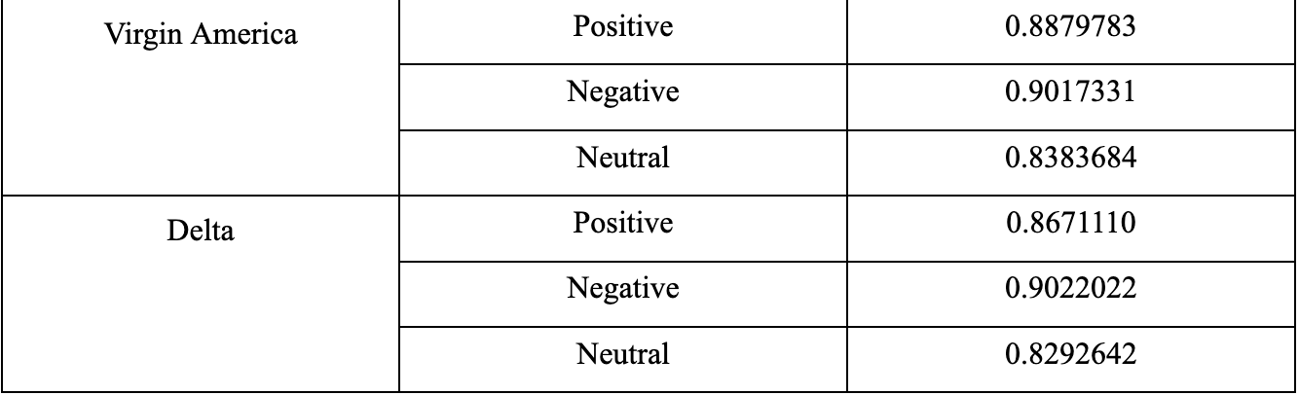
Which airline has the highest negative, neutral and positive sentiments?
The most negative sentiment: US airways (mean airline sentiment confidence of .946).
The most neutral sentiment: United (mean airline sentiment confidence of .810).
The most positive sentiment: Virgin America (mean airline sentiment confidence of .946).

Slide 5
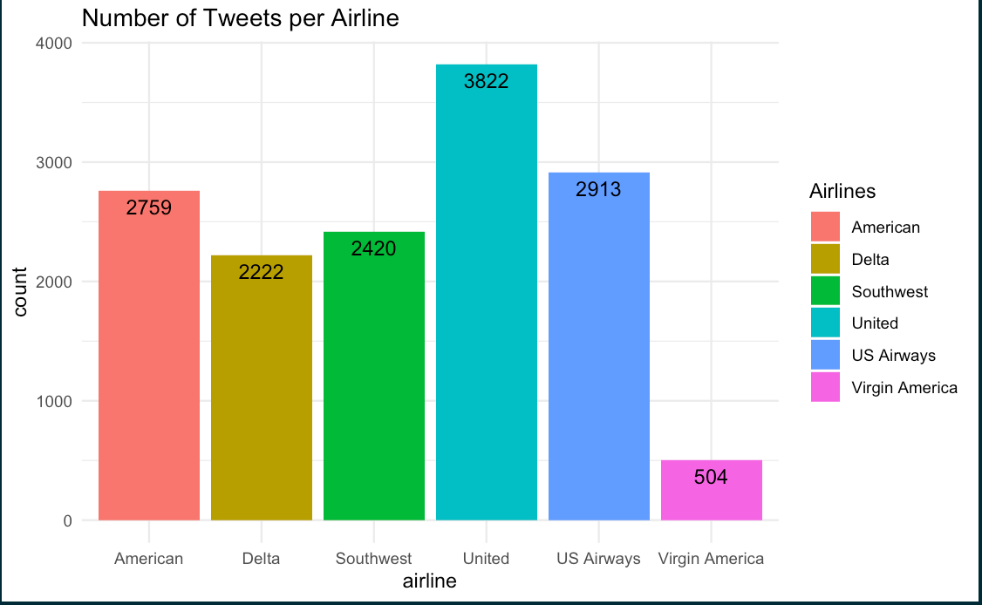
Which airlines do consumers tweet most about?
There were a total of 14,640 tweets (observations)
The most tweets: United Airline (3822 tweets).
Least amount of tweets: Virgin America (504 tweets)
Virgin America flies to 30 destinations total, so they have relatively small flight times and a minimum number of routes when compared to other airlines
Since Virgin America has less passengers than another airline

Slide 6
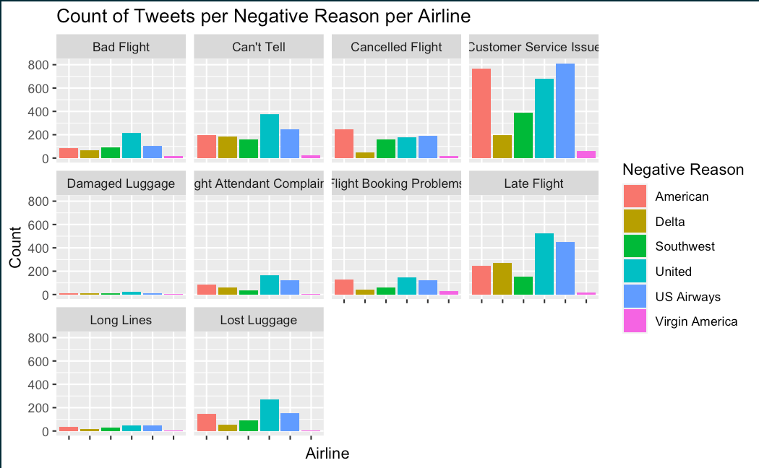
What are the main reasons for the negative tweets?
Which airline has the worst rating for each negative reason?
Only used the airline sentiments that were negative
The most listed negative reason was “Customer Service Issues” (31.7%)
The least listed negative reason was “Damaged Luggage” (.81%)
The airline with the most “Customer Service Issues” was US Airways (27.9% )
The airline with the least “Customer Service Issues” was Virgin America (2.10%)

Slide 7
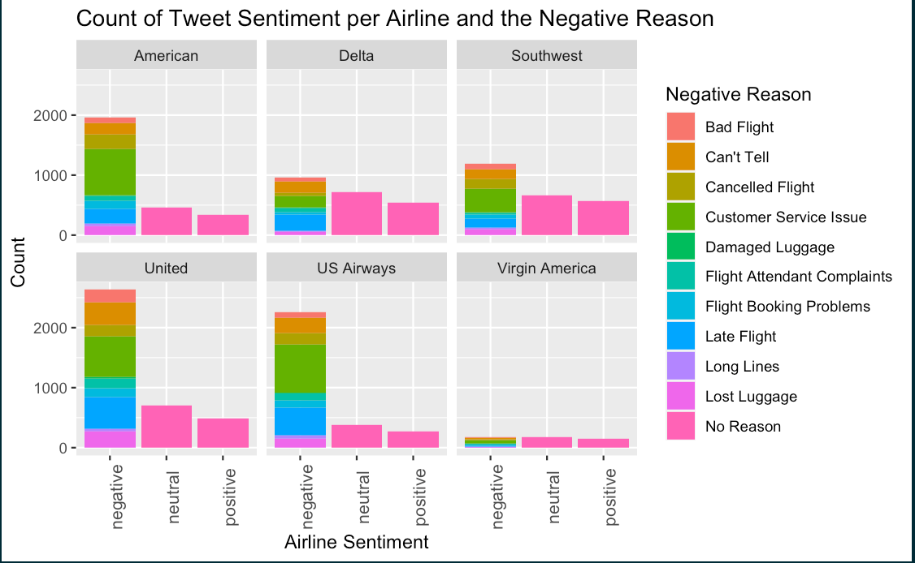
What is the overall positive, negative and neutral sentiment per airline?
What are the top three negative reasons why for each airline?
Highest # of negative sentiment tweets: United (68.9%), Highest # of neutral sentiment tweets: Delta (32.5%), Highest # of positive sentiment tweets: Southwest (19.1%)
The most common negative reason was “Customer Service Issues”, expect for Delta’s which was “Late Flight”
The least common negative reason was “Damaged Luggage”

Slide 8
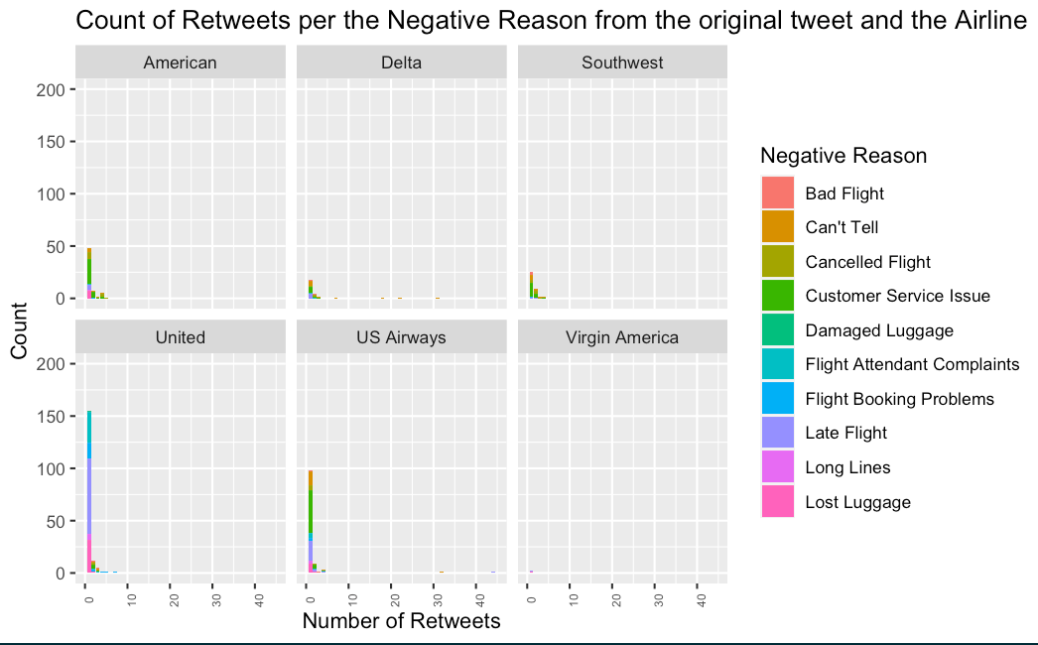
Was there a specific negative reason why the airline had a negative sentiment based on retweets?
Approximately 95% of all the tweets were not retweeted.
United and US Airways had the most retweets
Virgin America had the least retweets
The 2 most common negative reasons for retweets: “Customer Service Issues” ( 25.8%) & “Can’t Tell” (25.6%)
The least common negative reason for retweets: “Damaged Luggage” (.58% of all the retweets)

Slide 9
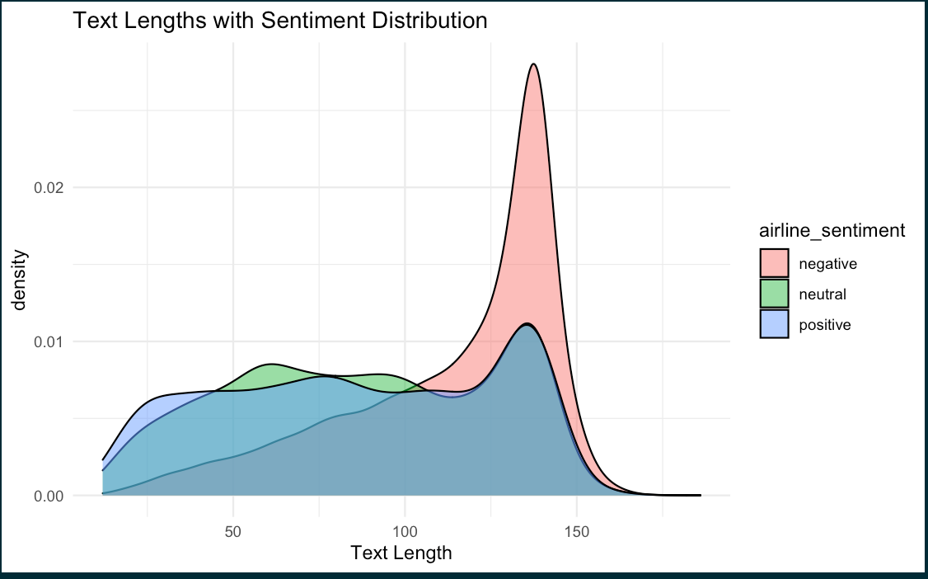
Does the length of the text show anything about the Sentiment?
We can see that most of the longer tweets have a negative sentiment
Most of the shorter tweets are neutral or positive.

Slide 10
Recommendations
American
They need to work on their customer service- 40.1% of their negative sentiment tweets are because of their Customer Service Issues
Delta
They need to work on not have late flights- 28.2% of their negative sentiment tweets are because of they had Late Flights
Southwest
They need to work on their customer service- 33% of their negative sentiment tweets are because of their Customer Service Issues
United
They need to work on their customer service- 25.9% of their negative sentiment tweets are because of their Customer Service Issues
US Airways
They need to work on their customer service- 35.8% of their negative sentiment tweets are because of their Customer Service Issues
Virgin America
They need to work on their customer service- 33.1% of their negative sentiment tweets are because of their Customer Service Issues

Slide 11
Appendix
Twitter Dataset: Brief Explanation of the Dataset
Analysis Review: What variables were kept and didn’t keep
Which airline has the highest negative, neutral and positive sentiments? Most negative sentiment: US airways; Most neutral sentiment: United; Most positive sentiment: Virgin America
Which airlines do consumers tweet most about? Most tweets: United Airline; Least tweets: Virgin America What are the main reasons for the negative tweets? Which airline has the worst rating for each negative reason? The most listed negative reason was “Customer Service Issues”; The least listed negative reason was “Damaged Luggage”; The airline with the most “Customer Service Issues” was US Airways; The airline with the least “Customer Service Issues” was Virgin America
What is the overall positive, negative and neutral sentiment per airline? What are the top three negative reasons why for each airline? Highest # of negative sentiment tweets: United, Highest # of neutral sentiment tweets: Delta, Highest # of positive sentiment tweets: Southwest; The most common negative reason was “Customer Service Issues”; The least common negative reason was “Damaged Luggage”
Was there a specific negative reason why the airline had a negative sentiment based on retweets? Most common negative reasons for retweets: “Customer Service Issues” & “Can’t Tell”; The least common negative reason for retweets: “Damaged Luggage”
Does the length of the text show anything about the Sentiment? The longer the tweet, the more likely it has a negative sentiment
Frequency: Most common words that are negative reasons: “delay”, “cancelled”, “service”; Most tweeted airlines: United, American, US Airways and Southwest airlines

Slide 12
Resources/References
https://stackoverflow.com/questions/22286419/move-a-column-to-first-position-in-a-data-frame
https://www.marsja.se/how-to-remove-a-column-in-r-using-dplyr-by-name-and-index/
https://www.statology.org/r-mean-by-group/
https://stackoverflow.com/questions/24172111/change-the-blank-cells-to-na
https://stackoverflow.com/questions/26553526/how-to-add-frequency-count-labels-to-the-bars-in-a-bar-graph-using-ggplot2
https://stackoverflow.com/questions/31939643/make-a-table-showing-the-10-largest-values-of-a-variable-in-r
https://www.geeksforgeeks.org/change-color-of-bars-in-barchart-using-ggplot2-in-r/
https://stackoverflow.com/questions/29278153/plotting-with-ggplot2-error-discrete-value-supplied-to-continuous-scale-on-c
https://www.codingprof.com/3-ways-to-replace-blanks-with-nas-in-r-examples
https://sparkbyexamples.com/r-programming/replace-character-in-a-string-of-r-dataframe/
https://r-lang.com/r-max-function-how-to-find-maximum-value-of-vector/
https://www.statmethods.net/graphs/bar.html
https://medium.com/@rohitnair_94843/analysis-of-twitter-data-using-r-part-2-word-cloud-dd423af1b2c6
https://towardsdatascience.com/twitter-text-analysis-in-r-ed7b81ecdb9a
chrome-extension://efaidnbmnnnibpcajpcglclefindmkaj/https://cran.r-project.org/web/packages/tm/vignettes/tm.pdf
data_visualization_ggplot_cheatsheet.pdf
https://medium.com/analytics-vidhya/tdm-term-document-matrix-and-dtm-document-term-matrix-8b07c58957e2
https://www.programmingr.com/count-occurrences-in-column/
https://www.statology.org/r-remove-rows-with-na-in-one-column/
https://en.wikipedia.org/wiki/List_of_Virgin_America_destinations
https://en.wikipedia.org/wiki/List_of_Southwest_Airlines_destinations
https://en.wikipedia.org/wiki/List_of_US_Airways_destinations
https://en.wikipedia.org/wiki/Virgin_America
https://www.youtube.com/watch?v=-O7W___fnrE&t=88s

